Slide 1
ServiceNow
Knowledge Management Updates - Owner Group
BNS0244536
April 2026
Notes:
BNS0244536 | Business Needs Statement | ServiceNow
The custom field "Owner Group" (u_owner_group) on the Knowledge article is ineffective in determining the group responsible for managing the article; it solely indicates ownership of the knowledge or process. As a result, there is a need to deactivate this field as it does not accurately reflect the group with authority to manage the article content.
To achieve our desired business outcomes, we aim to reinstate the OOB field "Ownership Group" on the record to facilitate knowledge article management at the ownership group level. We intend to redirect any custom approval workflows to be routed to the ownership group instead of the IT Service Desk K Base group. Additionally, a comprehensive review of knowledge roles and Access Control Lists (ACLs) will be conducted to ensure alignment with our business objectives.
Requirements
Remove Field - Owner Group" (u_owner_group) on the Knowledge article
Reinstate the OOB field "Ownership Group"
Fix workflow - approval workflows to be routed to the ownership group

Slide 2
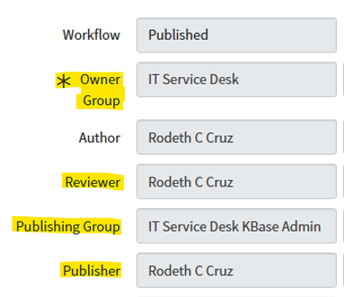
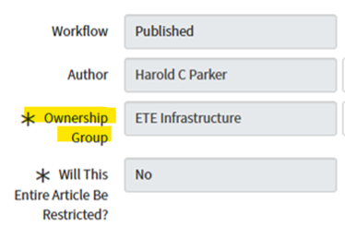
What is changing?
Removal of custom fields:
Owner Group
Reviewer
Publishing Group
Publisher
Reinstate OOB field:
Ownership Group
Current State:
Future State:

Slide 3
Ownership Group and Author Capabilities
Members of the Ownership Group:
Can view the entire article
(including restricted sections)
Can submit an article for retirement
Can edit the entire article
Approve publishing and retiring of an article
Are notified:
When the article is submitted for approval
When the article is published
When feedback is given
For expiring / expired articles
Author (If not in the Ownership Group):
Can view the entire article
(including restricted sections*)
Can submit an article for retirement
Is notified:
When the article is submitted for approval
When the article is published
When feedback is given
* If author is an “itil” user

Slide 4

Restricted Article / Sections
If an entire article is restricted:
Ownership Group members can view and edit the article
Users not in the Ownership Group will not see the article
Authors can view the article (even when not in the Ownership Group)
If article sections are restricted:
Ownership Group members can view and edit the entire article (including restricted sections.)
The Author can view the entire article (including restricted sections.)
Users who are not members of the restricted groups will not see restricted sections.

Slide 5
Create a KB Article

Slide 6
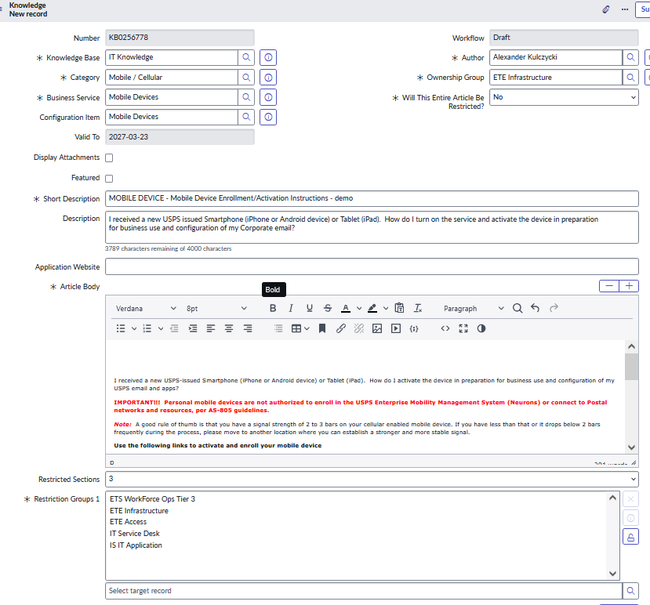


Create a new Knowledge Base Article
The Author:
Fills in article form
Selects Ownership Group
Submits form
Requests to publish article
Notes:
Author fills out form
Author selects ownership group
Author may or not be a member of ownership group
Author submits form
Author requests to publish article
Next, ownership group member will approve article

Slide 7
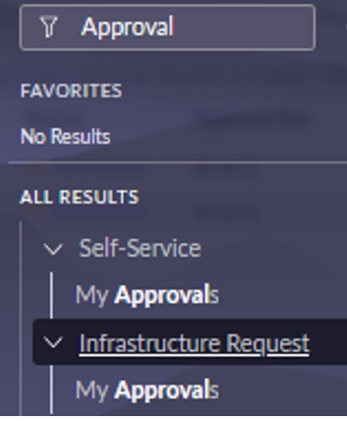
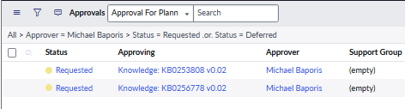
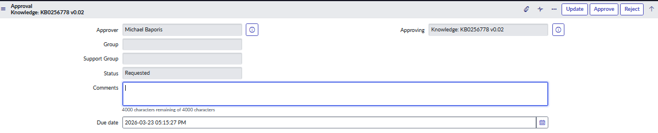
Create - OG member approves
Ownership Group members receive notification / click on the “My Approvals” menu to approve the article.

Slide 8
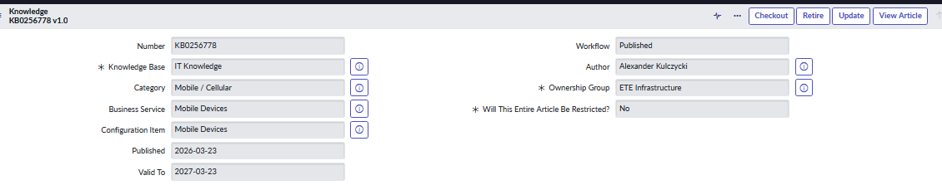
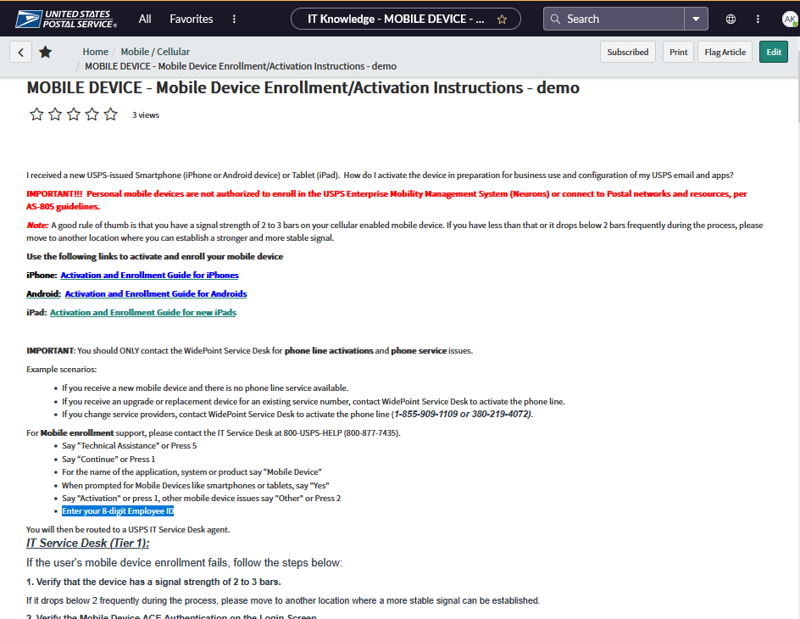
Create – KBA published
Article workflow moves to Published status, and the article is visible in the Service Portal

Slide 9
Edit a KB Article

Slide 10
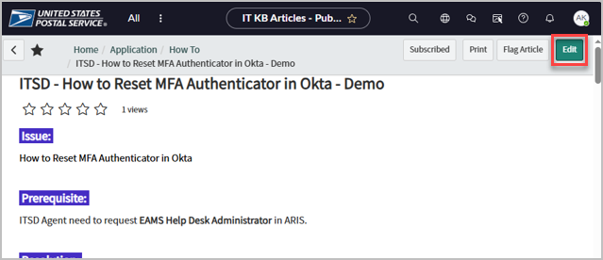
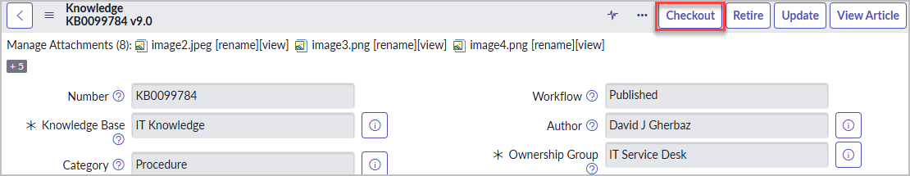

Edit - Existing article
A member of the Ownership Group can click [Edit] then [Checkout].
Once the Edits are done, the Ownership Group member clicks [Publish].
Notes:
The Author cannot click on Edit, nor edit the article once it’s checked out by OG , however, they can click on Publish.

Slide 11
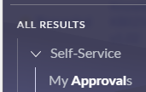
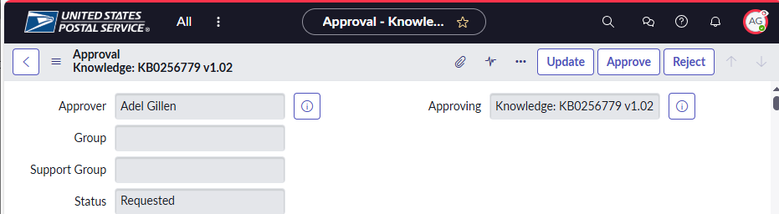
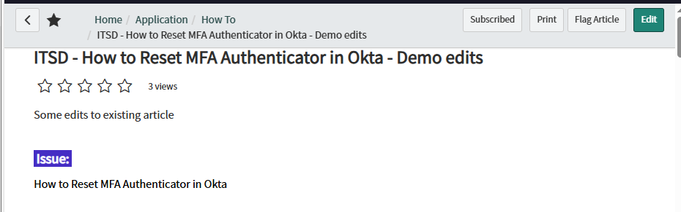
Edit – Approval / Publish
A member of the Ownership Group* clicks [Approve].
*Authors cannot approve their own articles.
Article is published and visible on front end
Notes:
As user Adel Gillen, member of ownership group IT Service Desk
Ownership Group Member approves to publish revised article

Slide 12
Reject a KB Article

Slide 13

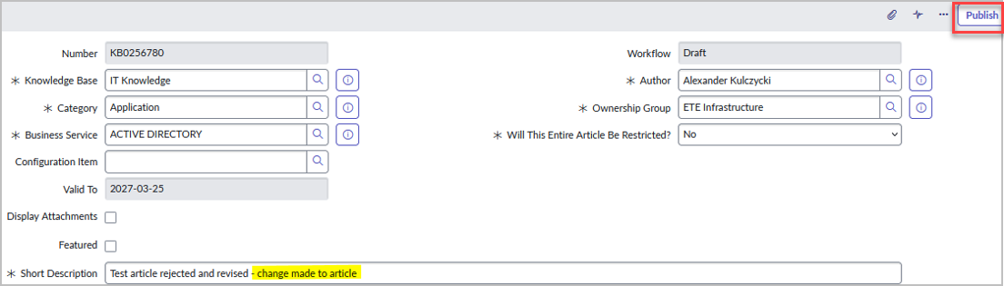
Article Rejected – revise and resubmit
A member of the Ownership Group* can Reject the Approval and the article will return to Draft where the Author can revise and resubmit.
*Authors cannot reject their own articles.
Notes:
Alternate path: Ownership Group member rejects article; Author revises and resubmits

Slide 14
Notifications

Slide 15
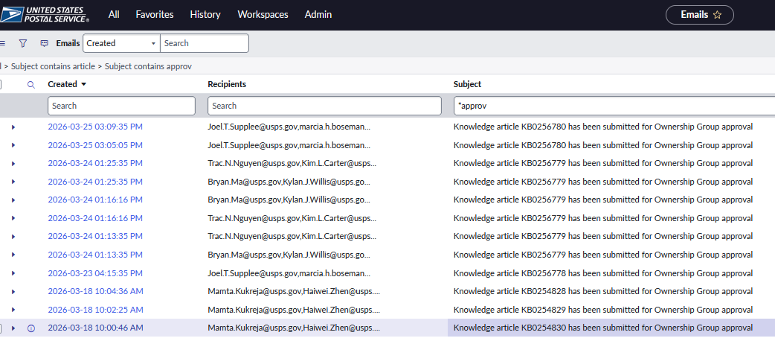
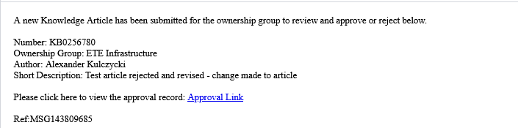
Approval Notification
Approval notifications are sent to the Ownership Group to request approval.

Slide 16
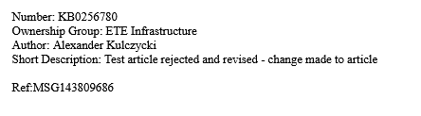
Published Notification
Published notifications are sent to the Author and Ownership Group that the article was published.

Slide 17
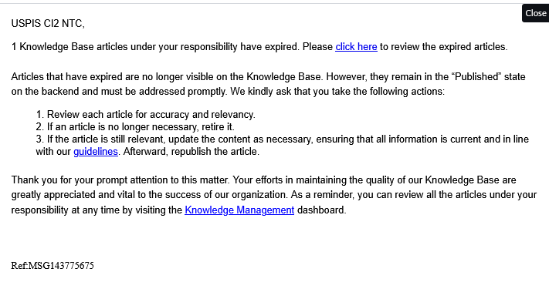
Expiry Notification
For the IT Knowledge Base:
Expiration notifications will continue to be sent to the Ownership Group based on the Valid To date.
Notification for articles that will expire.
Notification for articles that are expired.
Notes:
Admin or system runs job “Notification for Article Expiry Warning”. System generates email notification to OG members informing them of articles that will expire in next month (per valid_to date)
Admin or system runs job. “KB article expiry monthly” System generates email notification to OG members informing them of articles that have expired (per valid_to date)

Slide 18

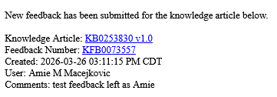
Feedback Notification
Feedback Notifications go to the Author, the Ownership Group, and the user who left the feedback.
Notes:
Feedback Notifications:
Goes to the Author, the Ownership Group, and the user who left the feedback.

Slide 19
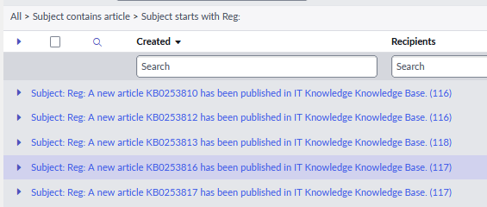
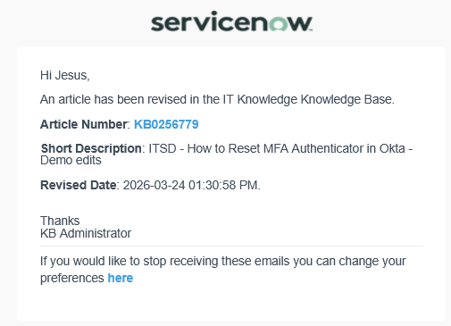

Subscription Notification
The ServiceNow subscription-based notification system sends emails to users if they are subscribed.
The subject starts with “Reg:”
Users can unsubscribe to notifications they don’t want.
Notes:
The ServiceNow subscription-based notification system sends many emails to users, subject starting with “Reg:”
Users can unsubscribe to notifications they don’t want.
Turning off certain subscription-based notifications for all users may be a future enhancement.

Slide 20
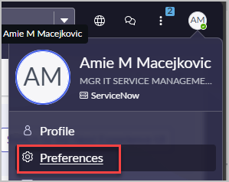
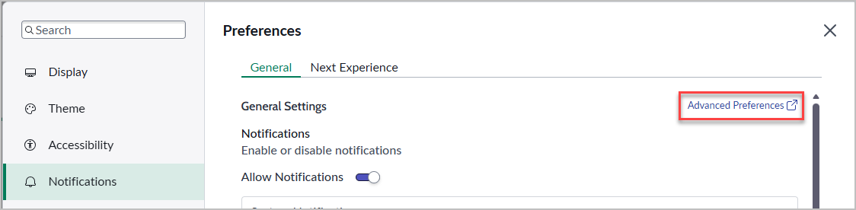
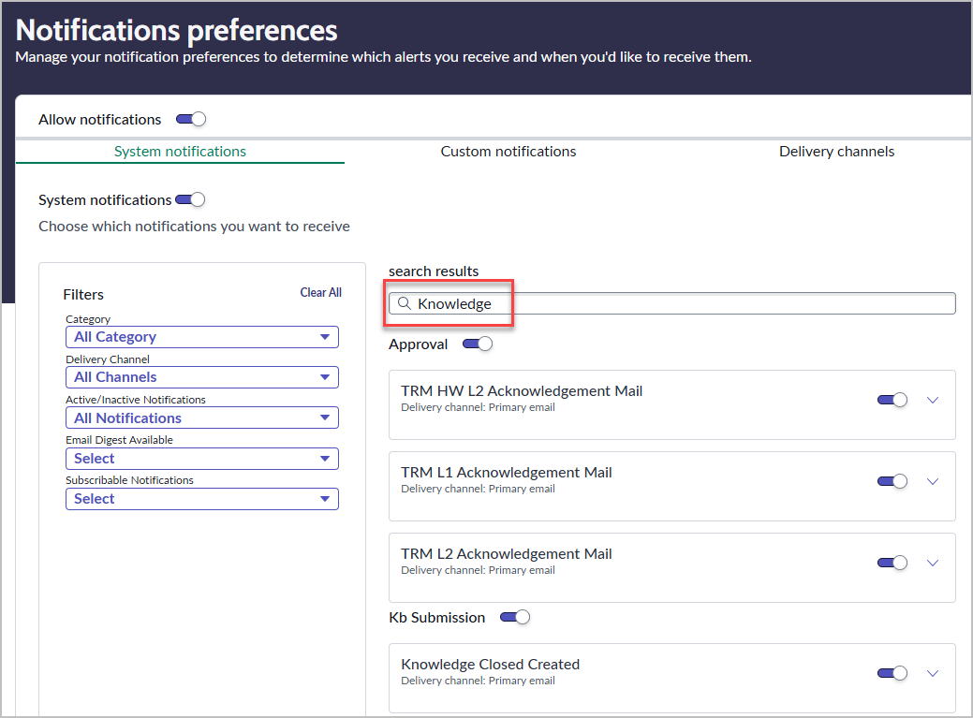
Unsubscribe from the Subscription Notifications
To Unsubscribe:
Click your initials
Go to Preferences > Notifications
Click on Advanced Preferences
A new tab will open
Filter by Knowledge
There are 4 sections: Approval, Submission, Feedback, and User triggered.
Toggle off the ones you don’t wish to receive.
*Note that this only affects the emails starting with Reg:

Slide 21
Call to Action:
Try out the Knowledge Base on the CAT Instance
https://uspstest.servicenowservices.com/
Report any issues to ServiceNowSupportManagers@usps.gov

Slide 22
Comments or Questions?

Slide 23
Appendix

Slide 24
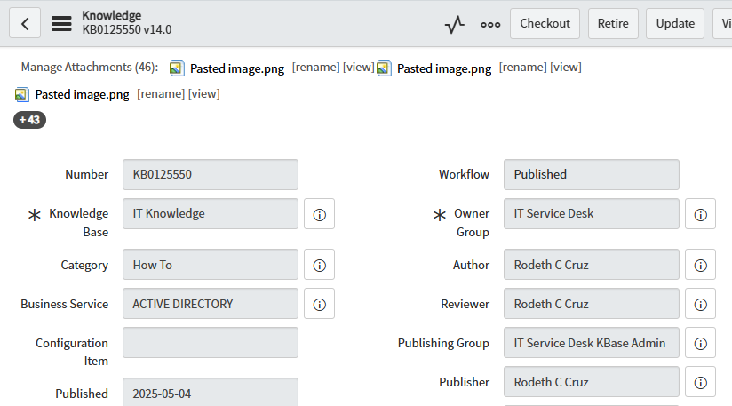
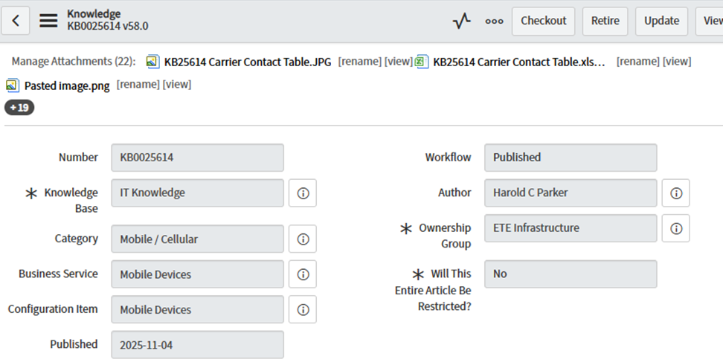





Updated Form
Current State:
Future State:
Notes:
The fields are removed from the form (inactive and hidden) but they remain on the table for traceability.

Slide 25
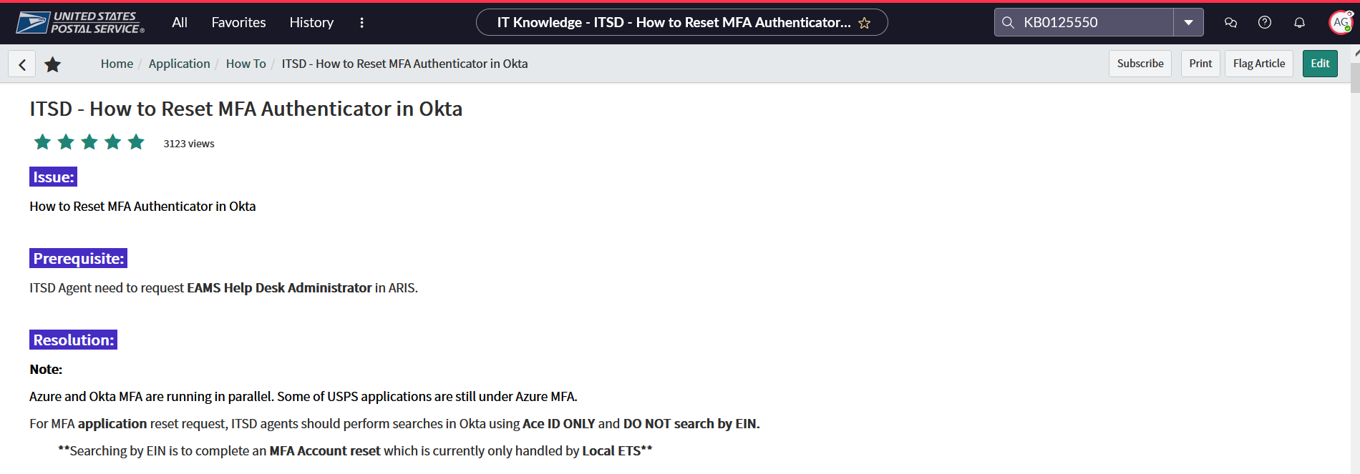
Restricted Article
If an entire article is restricted -- Users not in the Ownership Group will not see the article
Notes:
Adel Gillen, member of IT Service Desk, which is Ownership Group, can view restricted sections on front end and edit on backend.
KB0125550 “ITSD - How to Reset MFA Authenticator in...”

Slide 26
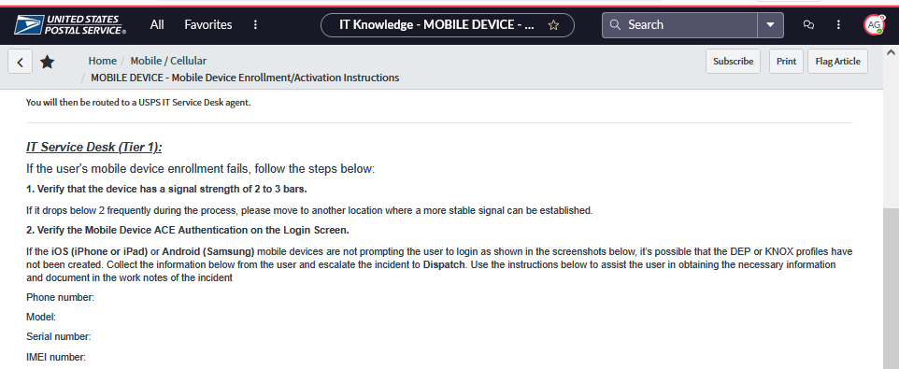
Restricted Sections
Article sections are restricted – Users not belonging to restriction groups will not see restricted sections.
Notes:
Michael Baporis, member of ETE Infrastructure, which is owner group, can view restricted article on front end and edit on backend.
KB0025614 “MOBILE DEVICE - Mobile Device Enrollment...”

Slide 27
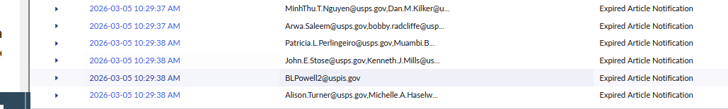

Article expiration
Notes:
Admin or system runs job “Notification for Article Expiry Warning”. System generates email notification to OG members informing them of articles that will expire in next month (per valid_to date)
Admin or system runs job. “KB article expiry monthly” System generates email notification to OG members informing them of articles that have expired (per valid_to date)

Slide 28
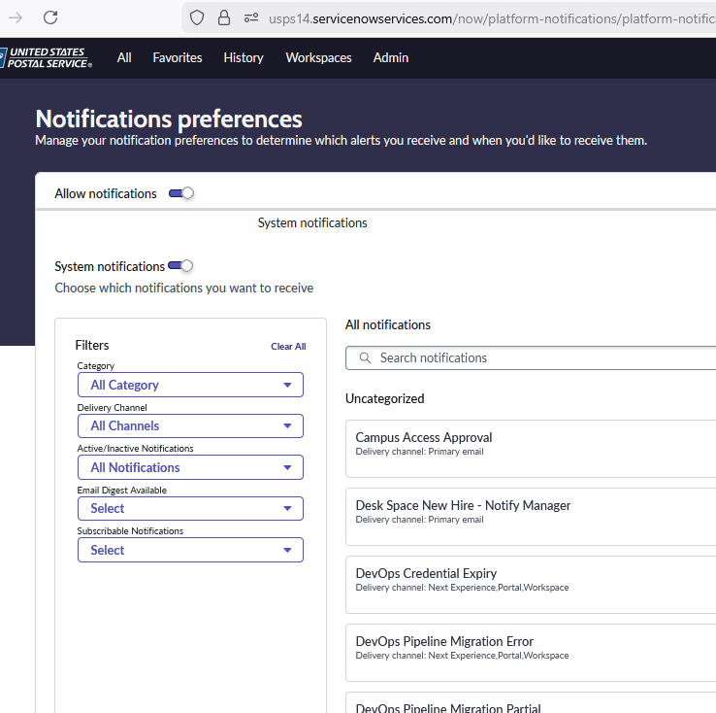
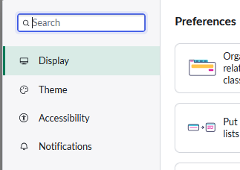
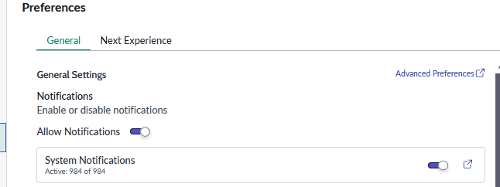


Unsubscribe (1/3)
Notes:
Unsubscribe
Go to User Profile
Preferences

Slide 29
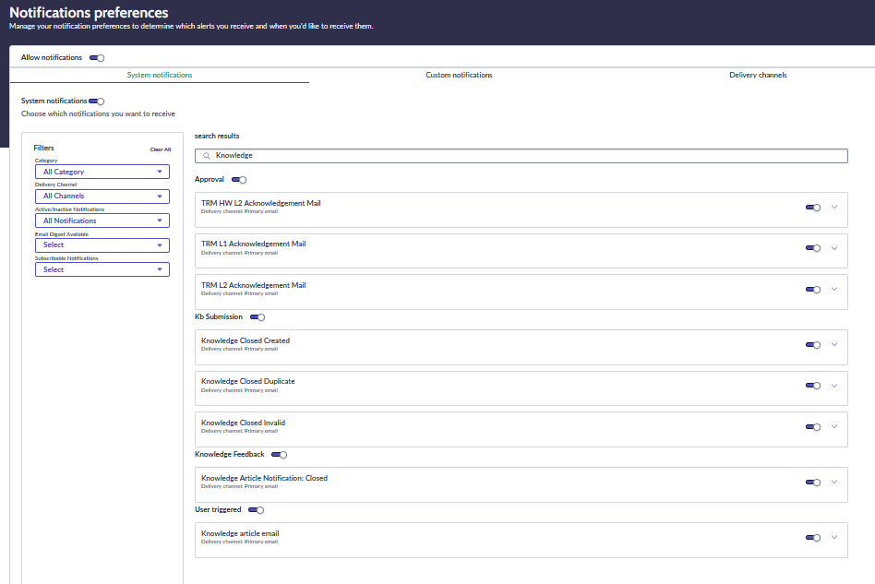
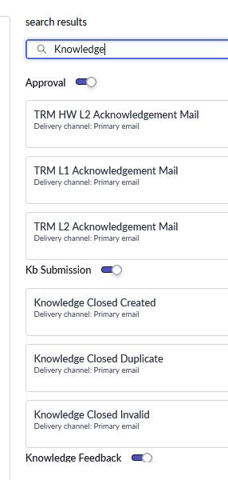

Unsubscribe (2/3)
Notes:
Unsubscribe
Go to User Profile
Preferences
Filter by Knowledge
I see 8 configurable settings
Also 4 additional toggles: Approval, Submission, Feedback, and User triggered.
Toggle off the ones you don’t wish to receive.

Slide 30
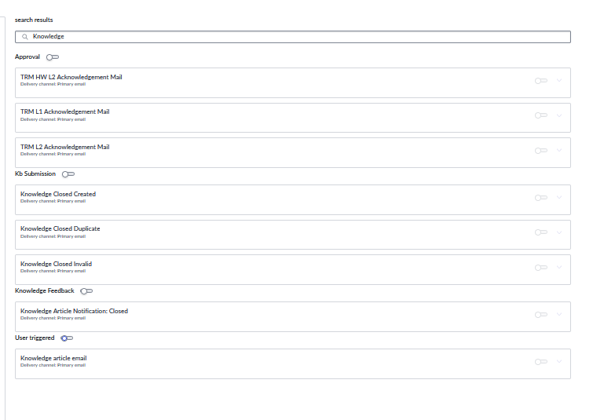
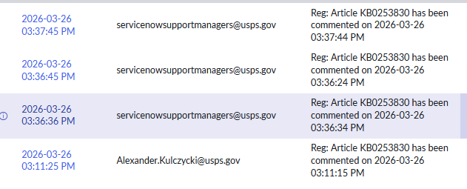

Unsubscribe (3/3)
Notes:
Unsubscribe
Go to User Profile
Preferences
Filter by Knowledge
I see 8 configurable settings
Also 4 additional toggles: Approval, Submission, Feedback, and User triggered.
Toggle off the ones you don’t wish to receive.
Looks like it worked: I stopped receiving the Reg: emails about knowledge after I unsubscribed.
(Please note that this only affects the emails starting with Reg: )

Slide 31
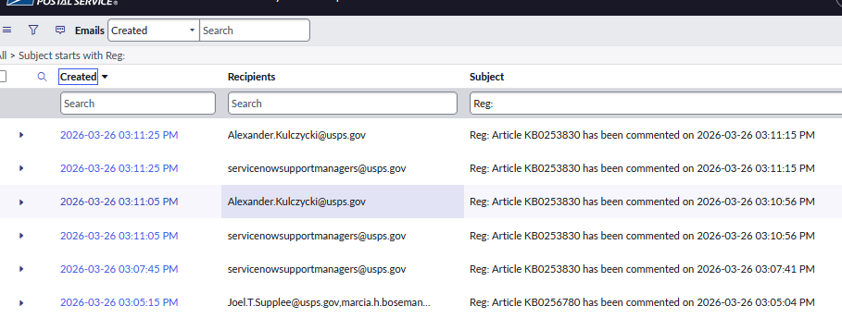
Feedback Notifications (2/2)
Notes:
Feedback that goes via subscriptions to the author and OG.

Slide 32
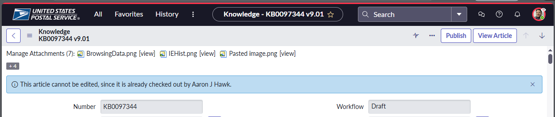
For slide 10 “Edit – Existing article”,
Notes:
Screenshot supporting comment thread on Slide 10: "Edit Existing Article".
Here, Author can not edit article because it is checked out for editing by an Ownership Group member.

